Slide 1
Level 1 Logical DFD - Eventify System
02.01 Search and Filter – DF-In
User Stories
01.01 Register User
Session/Role
02.01 Search and Filter Functionality
DF-in
02.02 View Event Details
01.04 Manage Profile

Slide 2
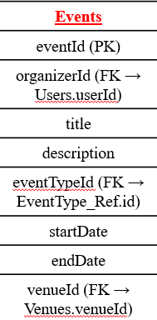
Level 1 Physical DFD - Eventify System
02.01 Search and Filter – DF-In
User Stories
Data Stores
01.01 Register User
Session/Role
02.01 Search and Filter Functionality
DF-in
02.02 View Event Details
Selection
01.04 Manage Profile

Slide 3
Level 1 Logical DFD - Eventify System
02.03 Save Event To Favorites – DF-Out
User Stories
02.03 Save Event To Favorites
01.05 View User Dashboard
DF-Out
Alerts
02.02 View Event Details
05.01 Send Reminders and SMS

Slide 4
Level 1 Physical DFD - Eventify System
02.03 Save Event To Favorites – DF-Out
User Stories
Data Stores
02.03 Save Event To Favorites
01.05 View User Dashboard
DF-Out
Alerts
05.01 Send Reminders and SMS

Slide 5
Level 1 Logical DFD - Eventify System
02.04 Share Event – DF-Out
User Stories
02.04 Share Event
DF-out
02.02 View Event Details
Sharing Details

Slide 6
Level 1 Physical DFD - Eventify System
02.04 Share Event – DF-Out
User Stories
Data Stores
02.04 Share Event
02.02 View Event Details
DF-out
Sharing Details

Slide 7
Level 1 Logical DFD - Eventify System
03.02 Purchase Tickets (Promocodes and Discounts) – DF-In
User Stories
03.01 View Pricing and Spot Availability
DF-In
03.02 Purchase Tickets (Promocodes and Discounts)
03.03 Generate Digital QR Tickets

Slide 8
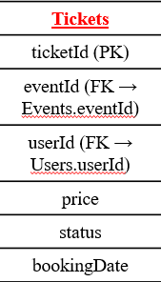
Level 1 Physical DFD - Eventify System
03.02 Purchase Tickets (Promocodes and Discounts) – DF-In
User Stories
Data Stores
03.01 View Pricing and Spot Availability
DF-In
03.02 Purchase Tickets (Promocodes and Discounts)
03.03 Generate Digital QR Tickets
Ticket Info

Slide 9
Level 1 Logical DFD - Eventify System
03.03 Generate Digital QR Tickets – DF-Out
User Stories
03.03 Generate Digital QR Tickets
03.02 Purchase Tickets
DF-Out
Notes:
P

Slide 10
Level 1 Physical DFD - Eventify System
03.03 Generate Digital QR Tickets – DF-Out
User Stories
Data Stores
03.03 Generate Digital QR Tickets
DF-Out

Slide 11
Level 1 Logical DFD - Eventify System
04.01 Create and Edit Event – DF-In
User Stories
01.01 Register User
04.01 Create and Edit Event
DF-In
02.02 View Event Details

Slide 12
Level 1 Physical DFD - Eventify System
04.01 Create and Edit Event – DF-In
User Stories
Data Stores
01.01 Register User
04.01 Create and Edit Event
DF-In
02.02 View Event Details

